Slide 1
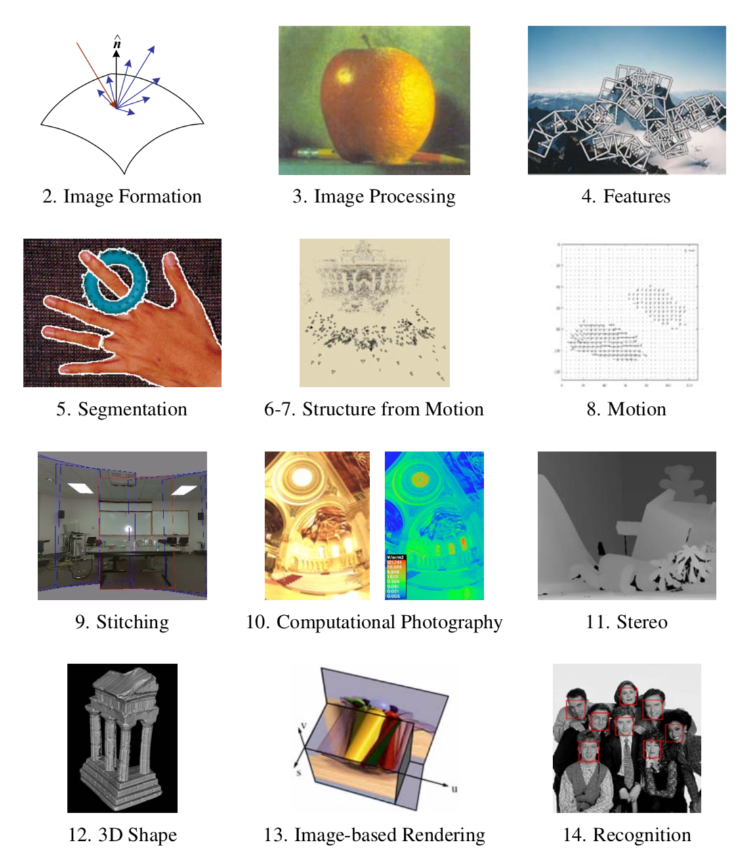

Slide 2
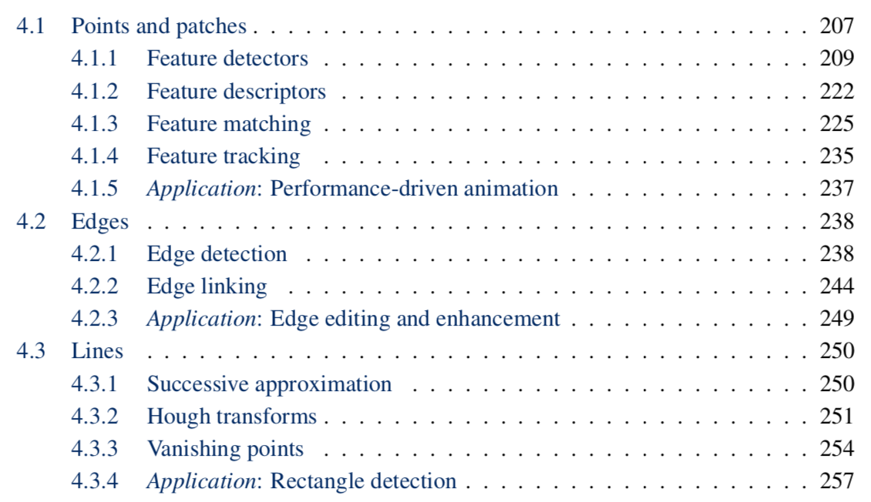

Slide 3
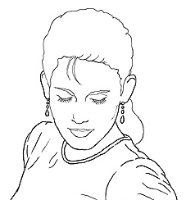
Edge detection
Goal: map image from 2d array of pixels to a set of curves or line segments or contours.
Why?
Main idea: look for strong gradients, post-process
Figure from J. Shotton et al., PAMI 2007
Figure from D. Lowe
Slide credit: Kristen Grauman

Slide 4
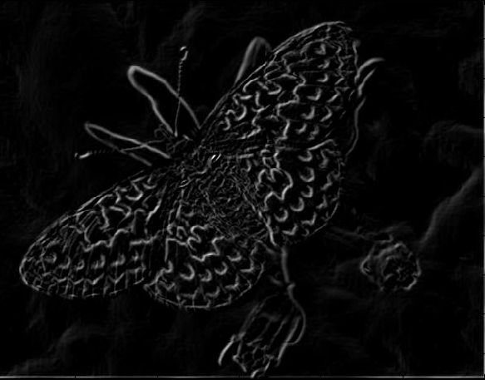
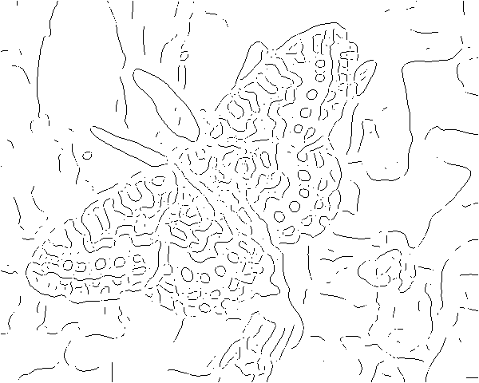
Gradients → edges
Primary edge detection steps:
1. Smoothing: suppress noise
2. Edge enhancement: filter for contrast
3. Edge localization
Determine which local maxima from filter output are actually edges vs. noise
Threshold, Thin
Slide credit: Kristen Grauman

Slide 5
Thresholding
Choose a threshold value t
Set any pixels less than t to zero (off)
Set any pixels greater than or equal to t to one (on)
Slide credit: Kristen Grauman

Slide 6
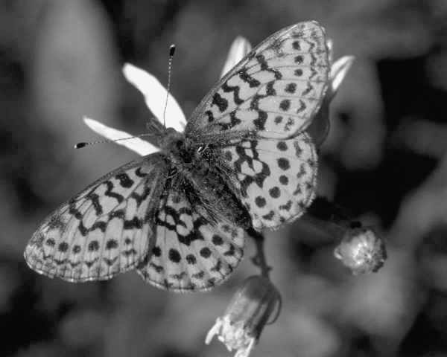
Original image
Slide credit: Kristen Grauman

Slide 7
Gradient magnitude image
Slide credit: Kristen Grauman

Slide 8
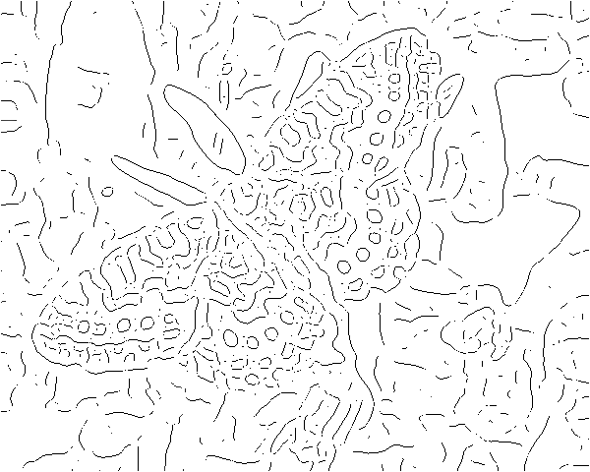
Thresholding gradient with a lower threshold
Slide credit: Kristen Grauman

Slide 9
Thresholding gradient with a higher threshold
Slide credit: Kristen Grauman

Slide 10
Canny edge detector
Filter image with derivative of Gaussian
Find magnitude and orientation of gradient
Non-maximum suppression:
Thin wide “ridges” down to single pixel width
Linking and thresholding (hysteresis):
Define two thresholds: low and high
Use the high threshold to start edge curves and the low threshold to continue them
MATLAB: edge(image, ‘canny’);
>>help edge
Slide credit: David Lowe, Fei-Fei Li

Slide 11

The Canny edge detector
original image (Lena)
Slide credit: Steve Seitz

Slide 12
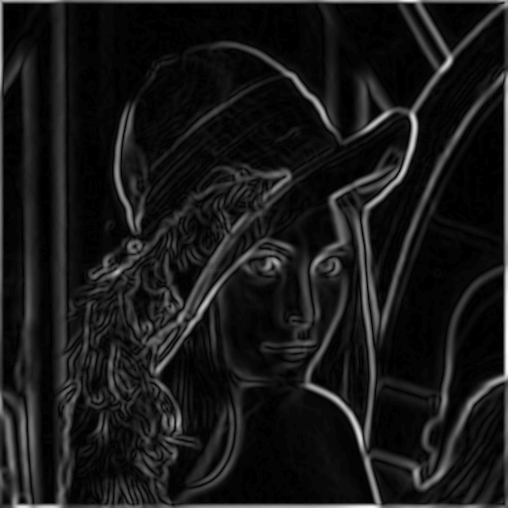
The Canny edge detector
norm of the gradient
Slide credit: Kristen Grauman

Slide 13
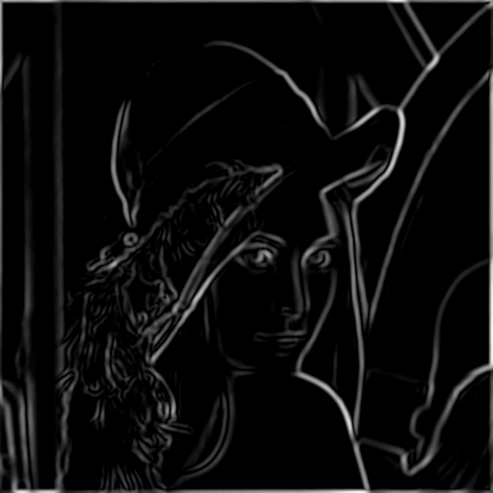
The Canny edge detector
thresholding
Slide credit: Kristen Grauman

Slide 14
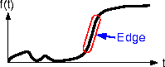
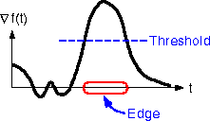
The Canny edge detector
How to turn these thick regions of the gradient into curves?
thresholding
Slide credit: Kristen Grauman

Slide 15

Non-maximum suppression
Check if pixel is local maximum along gradient direction
Select single max across width of the edge
Requires checking interpolated pixels p and r
Slide credit: Kristen Grauman

Slide 16
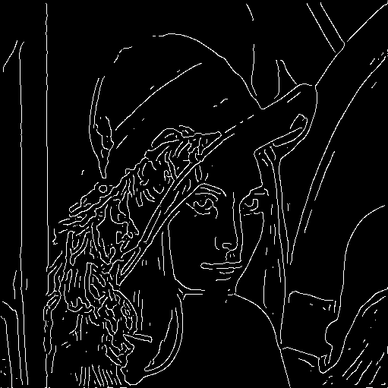
The Canny edge detector
Problem: pixels along this edge didn’t survive the thresholding
thinning
(non-maximum suppression)
Slide credit: Kristen Grauman

Slide 17
Hysteresis thresholding
Use a high threshold to start edge curves, and a low threshold to continue them.
Slide credit: Steve Seitz

Slide 18
Hysteresis thresholding
original image
high threshold
(strong edges)
low threshold
(weak edges)
hysteresis threshold
Slide credit: Fei-Fei Li

Slide 19
Recap: Canny edge detector
Filter image with derivative of Gaussian
Find magnitude and orientation of gradient
Non-maximum suppression:
Thin wide “ridges” down to single pixel width
Linking and thresholding (hysteresis):
Define two thresholds: low and high
Use the high threshold to start edge curves and the low threshold to continue them
MATLAB: edge(image, ‘canny’);
>>help edge
Slide credit: David Lowe, Fei-Fei Li

Slide 20
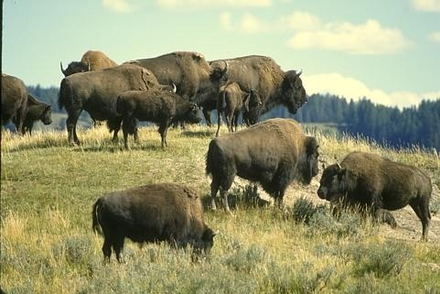
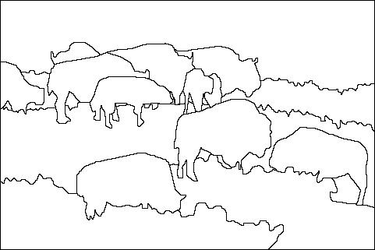
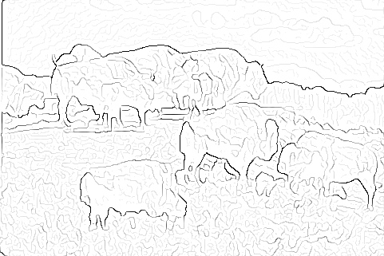
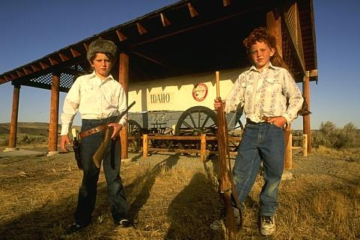
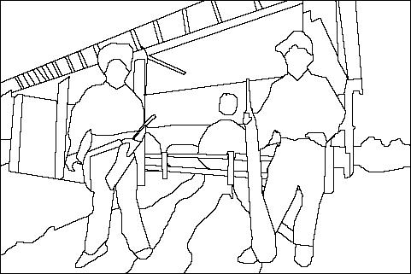
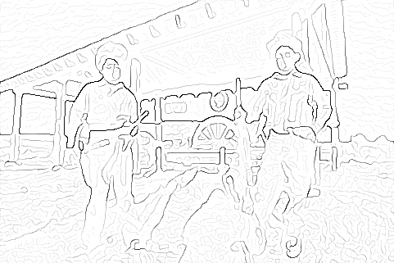
Low-level edges vs. perceived contours
image
human segmentation
gradient magnitude
Berkeley segmentation database: http://www.eecs.berkeley.edu/Research/Projects/CS/vision/grouping/segbench/
Slide credit: Svetlana Lazebnik

Slide 21
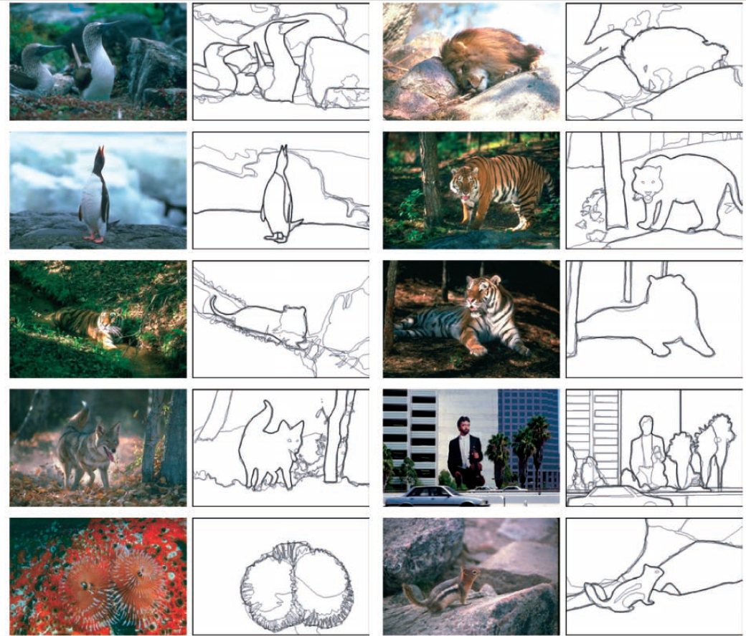
Learn from humans which combination of features is most indicative of a “good” contour?
[D. Martin et al. PAMI 2004]
Human-marked segment boundaries
Slide credit: Kristen Grauman

Slide 22
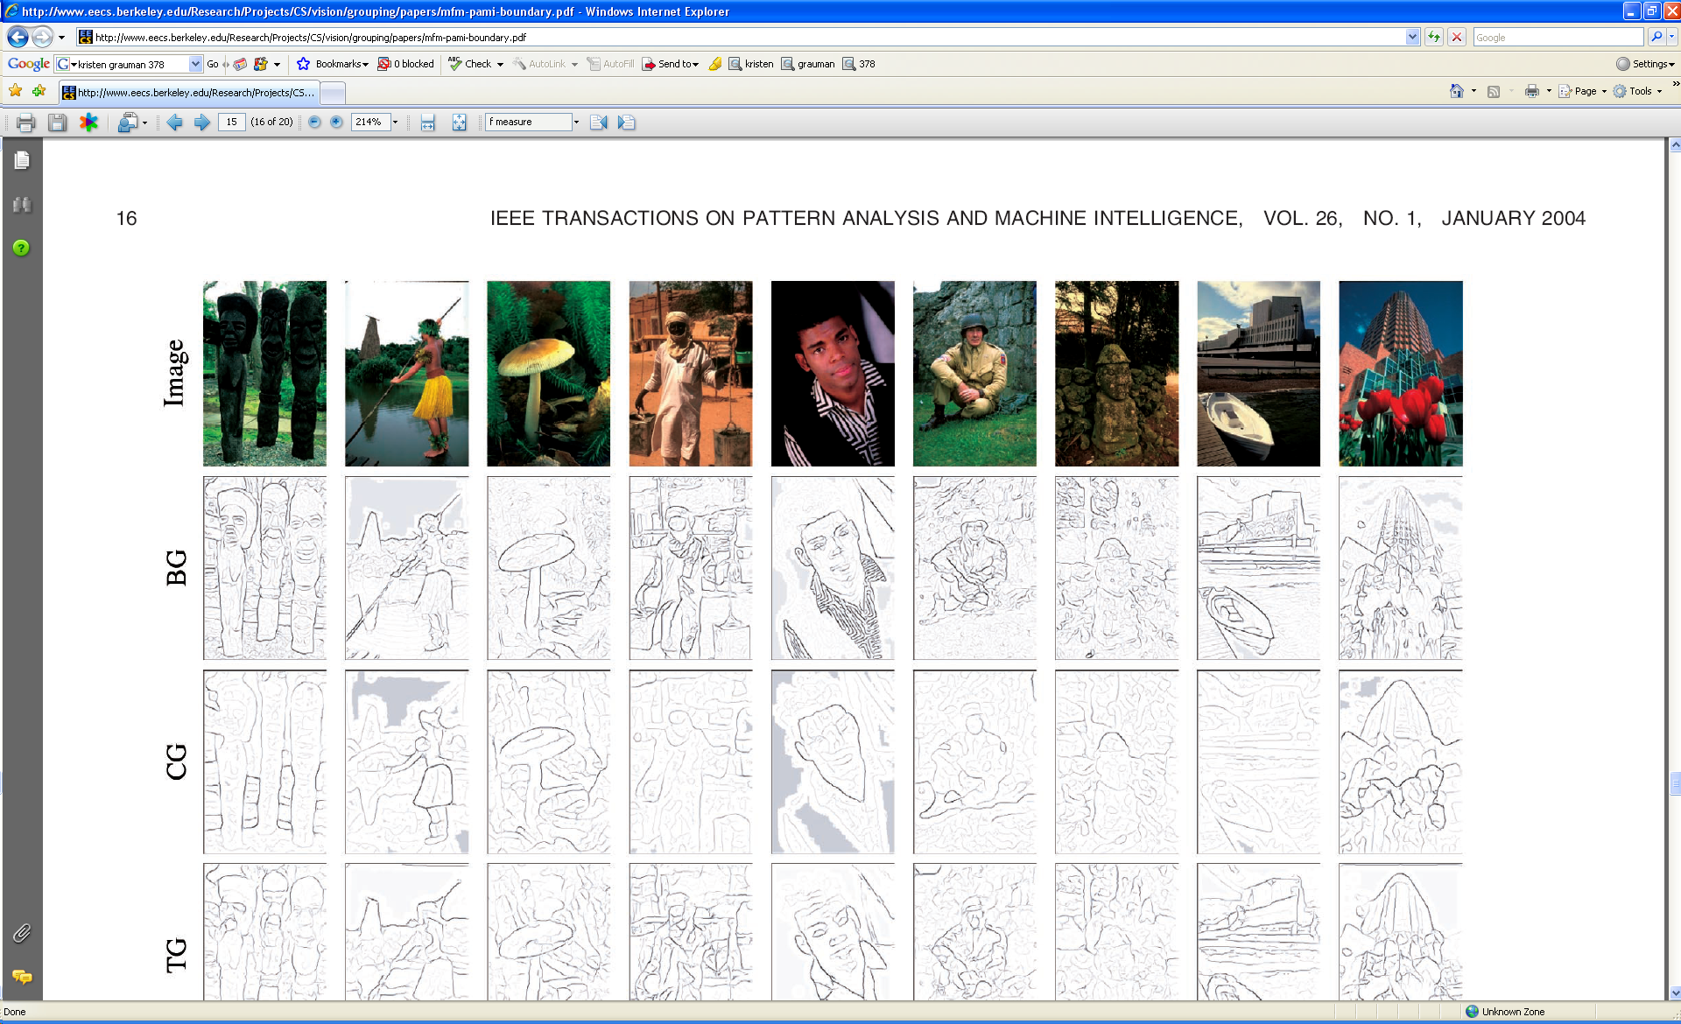
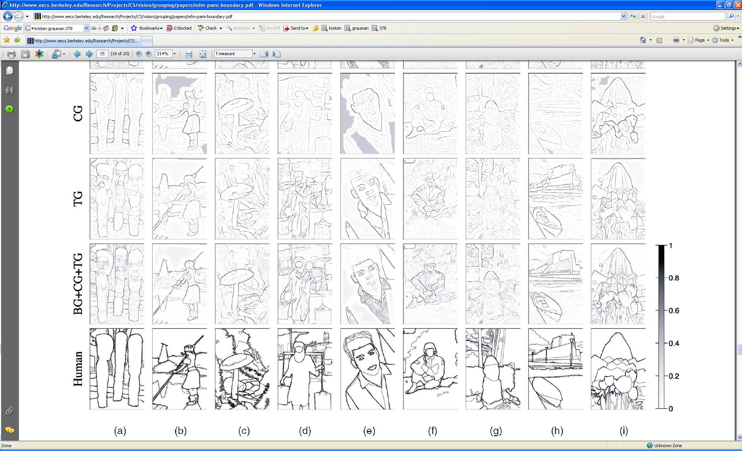
Slide credit: Kristen Grauman
[D. Martin et al. PAMI 2004]

Slide 23
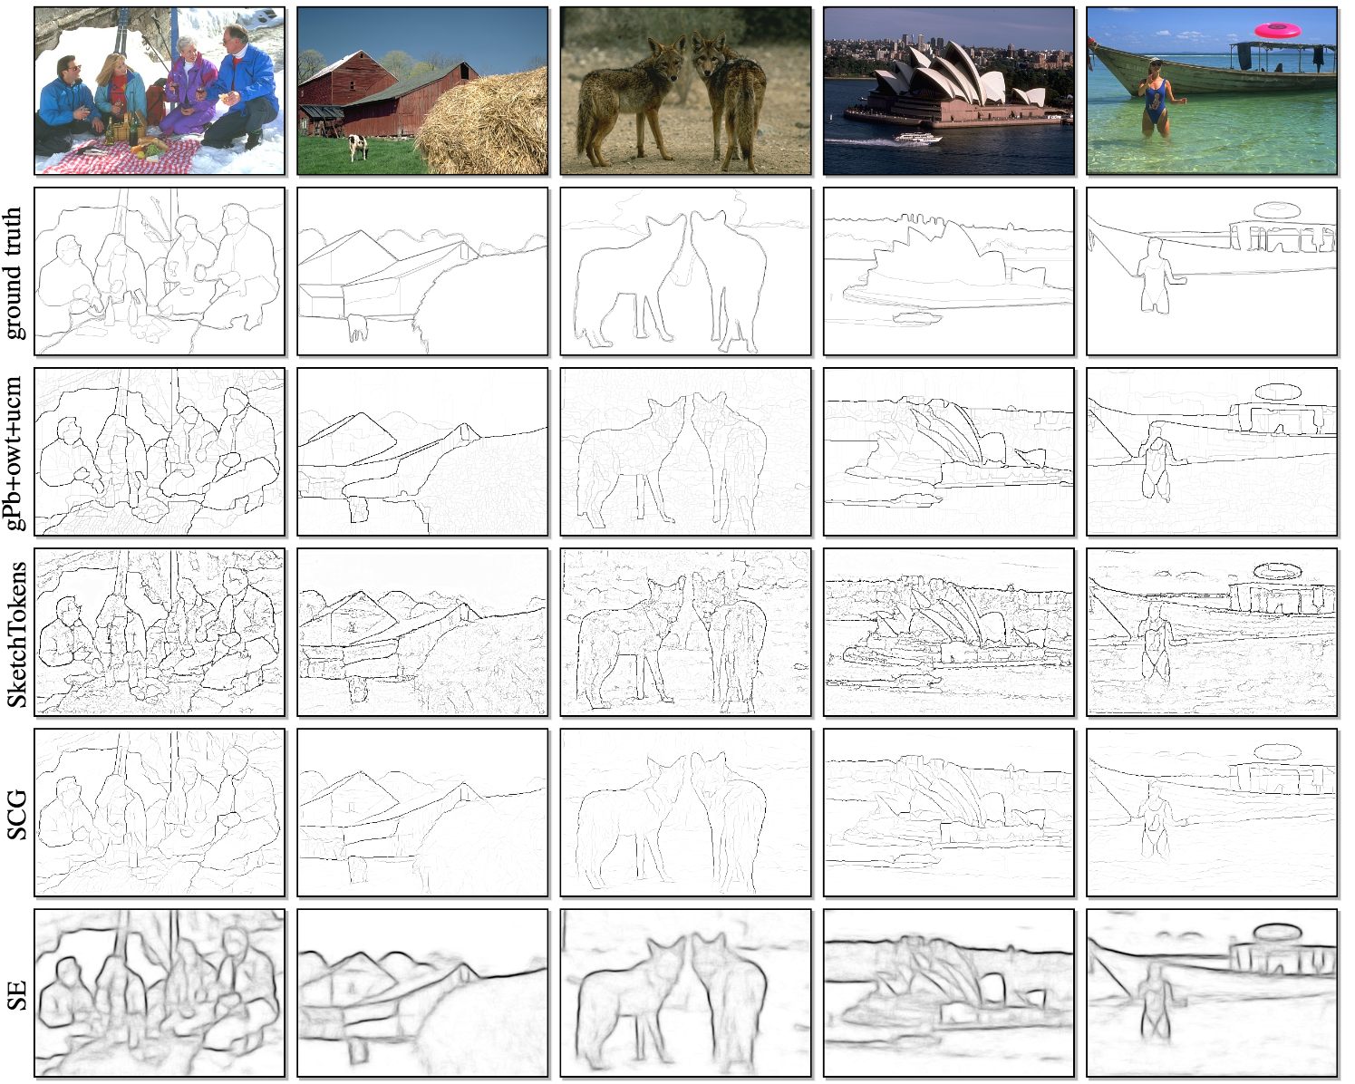
Slide credit: Devi Parikh
Figure from: Dollar and Zitnick, PAMI 2015

Slide 24
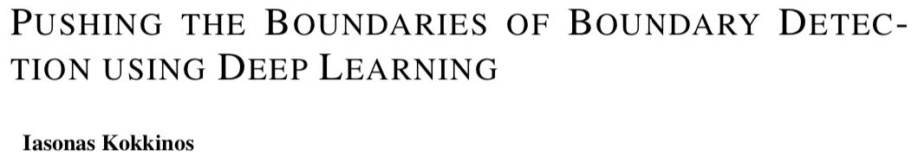
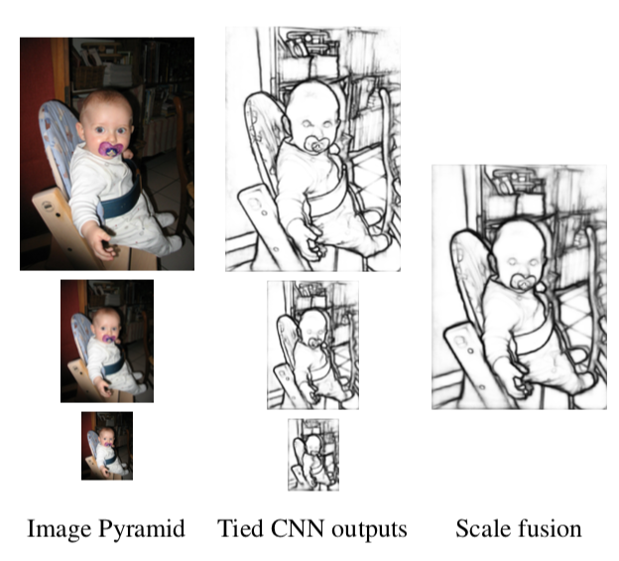
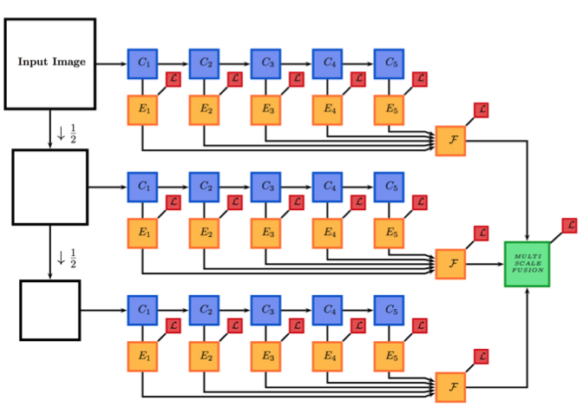
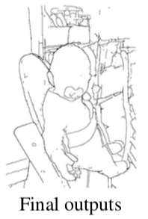
ICLR 2016

Slide 25
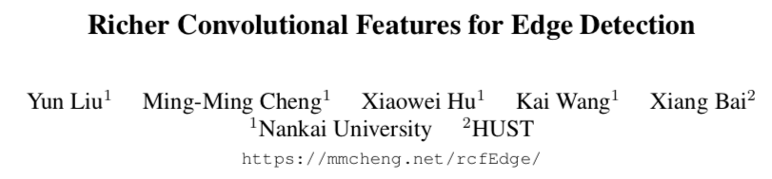
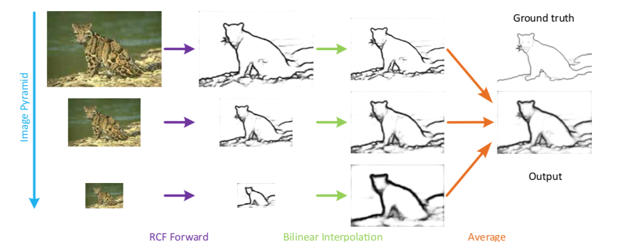
CVPR 2017

Slide 26
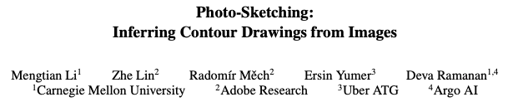
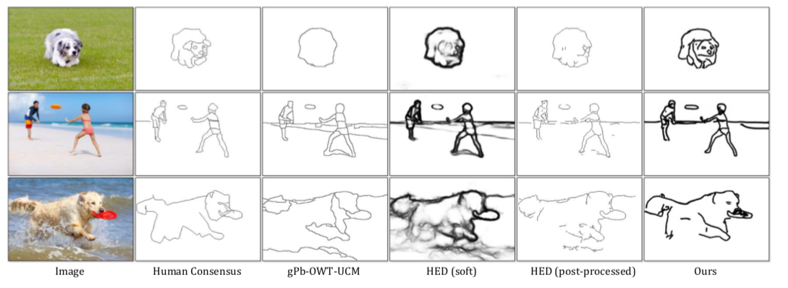
WACV 2019
Uses fairly advanced deep net technique (GANs), which we’ll discuss only later in the course.

Slide 28
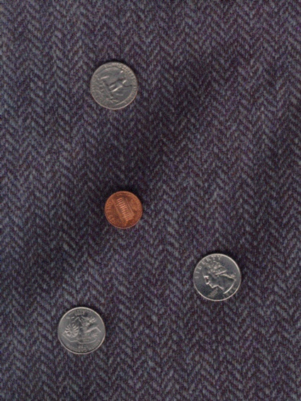
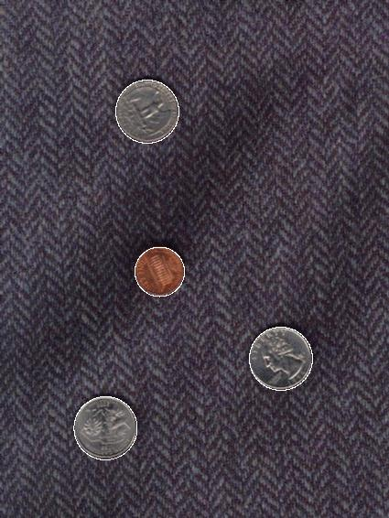
Voting and the Hough Transform
Disclaimer: Many slides have been borrowed from Devi Parikh and/or Kristen Grauman, who may have borrowed from others.
Slide credit: Kristen Grauman

Slide 29
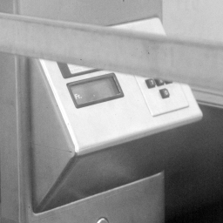
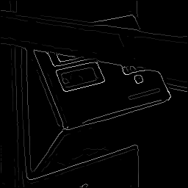
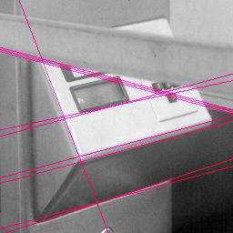
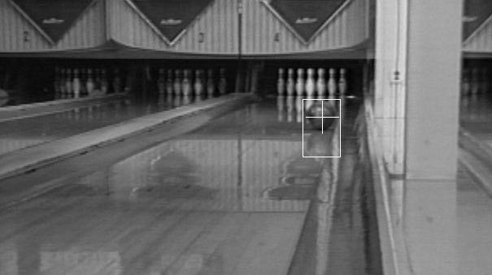
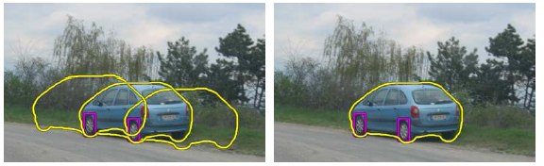
Fitting
Want to associate a model with observed features
[Fig from Marszalek & Schmid, 2007]
For example, the model could be a line, a circle, or an arbitrary shape.
Kristen Grauman

Slide 30
Fitting: Main idea
Choose a parametric model to represent a set of features
Membership criterion is not local
Can’t tell whether a point belongs to a given model just by looking at that point
Three main questions:
What model represents this set of features best?
Which of several model instances gets which feature?
How many model instances are there?
Computational complexity is important
It is infeasible to examine every possible set of parameters and every possible combination of features
Slide credit: L. Lazebnik

Slide 31
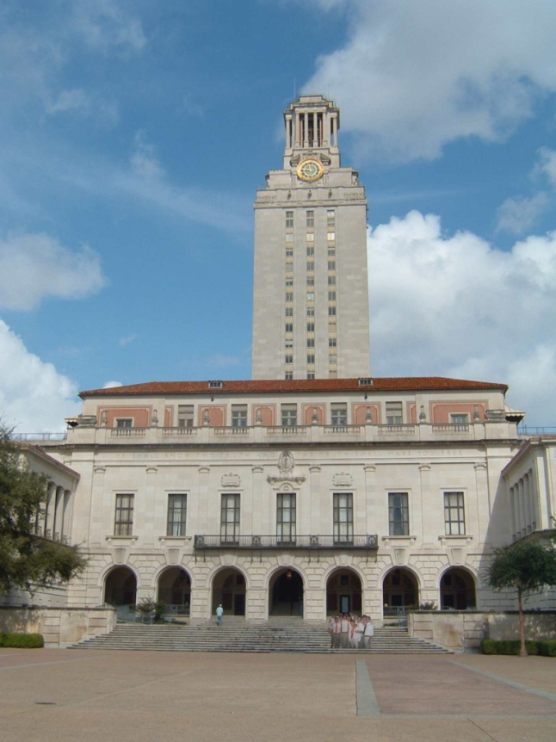
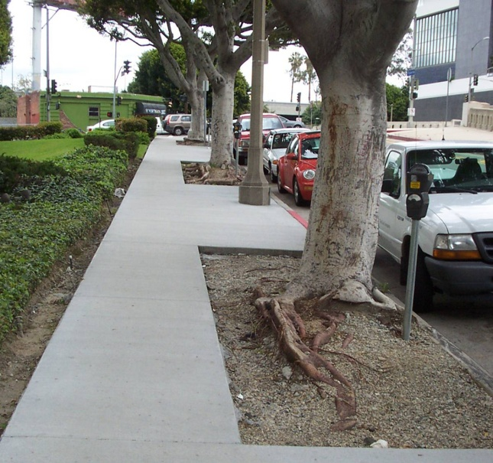
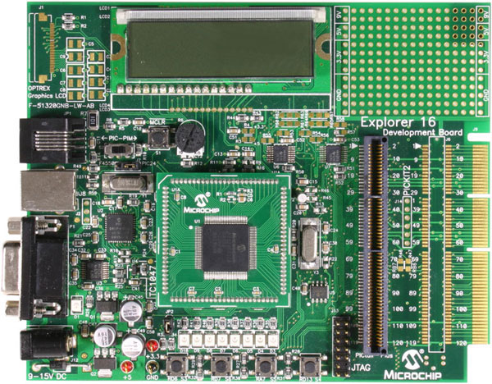
Example: Line fitting
Why fit lines?
Many objects characterized by presence of straight lines
Wait, why aren’t we done just by running edge detection?
Kristen Grauman

Slide 32
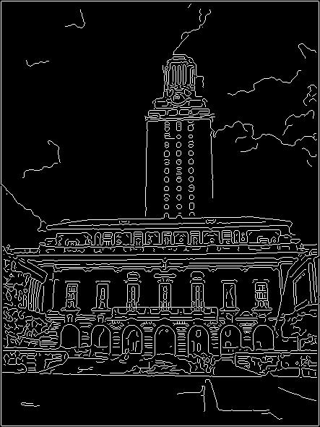
Difficulty of line fitting
Extra edge points (clutter), multiple models:
which points go with which line, if any?
Only some parts of each line detected, and some parts are missing:
how to find a line that bridges missing evidence?
Noise in measured edge points, orientations:
how to detect true underlying parameters?
Kristen Grauman

Slide 33
Voting
It’s not feasible to check all combinations of features by fitting a model to each possible subset.
Voting is a general technique where we let the features vote for all models that are compatible with it.
Cycle through features, cast votes for model parameters.
Look for model parameters that receive a lot of votes.
Noise & clutter features will cast votes too, but typically their votes should be inconsistent with the majority of “good” features.
Kristen Grauman

Slide 34
Fitting lines: Hough transform
Given points that belong to a line, what is the line?
How many lines are there?
Which points belong to which lines?
Hough Transform is a voting technique that can be used to answer all of these questions.
Main idea:
1. Record vote for each possible line on which each edge point lies.
2. Look for lines that get many votes.
Kristen Grauman

Slide 35
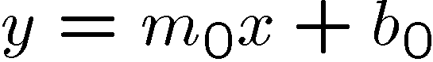
Finding lines in an image: Hough space
Equation of a line?
y = mx + b
y
b
b₀
x
m₀
m
image space
Hough (parameter) space
Connection image (x,y) and Hough (m,b) spaces:
Line in image corresponds to a point in Hough space
To go from image space to Hough space:
given a set of points (x,y), find all (m,b) such that y = mx + b
Slide credit: Steve Seitz

Slide 36
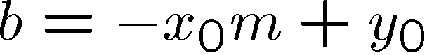
Finding lines in an image: Hough space
y
b
y₀
x₀
x
m
image space
Hough (parameter) space
Connection between image (x,y) and Hough (m,b) spaces
A line in the image corresponds to a point in Hough space
To go from image space to Hough space:
given a set of points (x,y), find all (m,b) such that y = mx + b
What does a point (x₀, y₀) in the image space map to?
Answer: the solutions of b = -x₀m + y₀
this is a line in Hough space
Slide credit: Steve Seitz

Slide 37
Finding lines in an image: Hough space
y
b
(x₁, y₁)
y₀
(x₀, y₀)
b = –x₁m + y₁
x₀
x
m
image space
Hough (parameter) space
What are the line parameters for the line that contains both (x₀, y₀) and (x₁, y₁)?
It is the intersection of the lines b = –x₀m + y₀ and b = –x₁m + y₁
Slide credit: Kristen Grauman

Slide 38
Finding lines in an image: Hough algorithm
y
b
x
m
image space
Hough (parameter) space
How can we use this to find the most likely parameters (m,b) for the most prominent line in the image space?
Let each edge point in image space vote for a set of possible parameters in Hough space
Accumulate votes in discrete set of bins; parameters with the most votes indicate line in image space.
Slide credit: Kristen Grauman

Slide 39
Polar representation for lines
Issues with usual (m,b) parameter space: can take on infinite values, undefined for vertical lines.
Image columns
[0,0]
: perpendicular distance from line to origin
: angle the perpendicular makes with the x-axis
Image rows
Point in image space → sinusoid segment in Hough space
Kristen Grauman

Slide 40

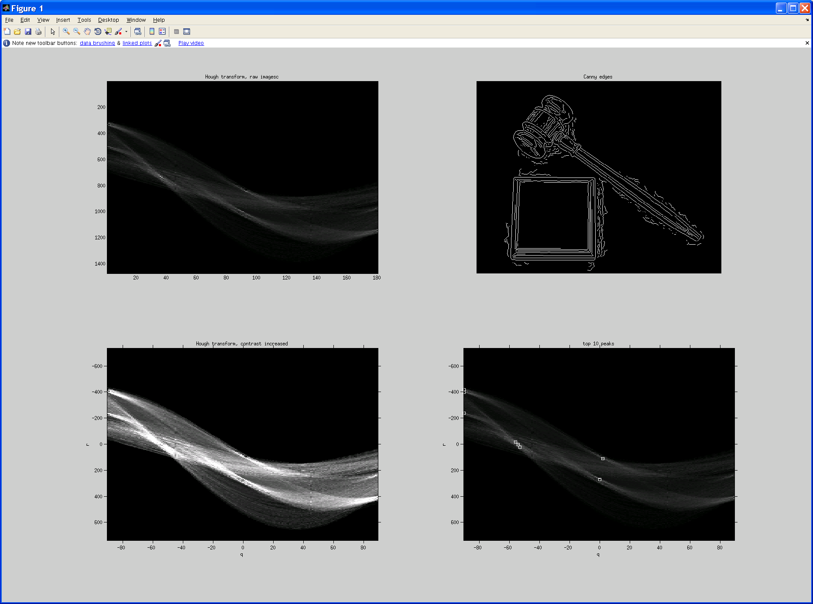
Original image
Canny edges
Vote space and top peaks
Kristen Grauman

Slide 41
Hough transform algorithm
Using the polar parameterization:
Basic Hough transform algorithm
Initialize H[d, θ]=0
for each edge point I[x, y] in the image
for θ = [θ_{min} to θ_{max} ] // some quantization
H[d, θ] += 1
Find the value(s) of (d, θ) where H[d, θ] is maximum
The detected line in the image is given by
H: accumulator array (votes)
d
θ
Source: Steve Seitz

Slide 42
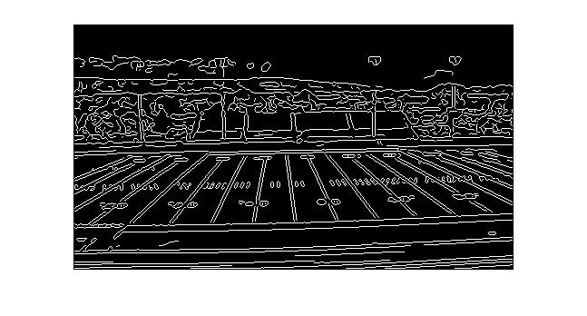
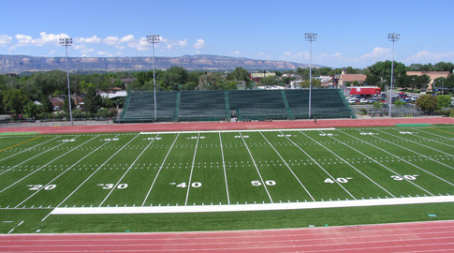
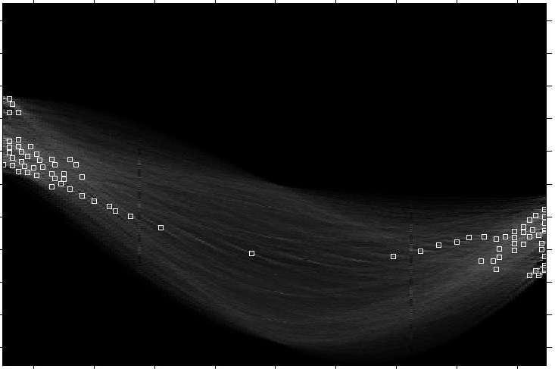
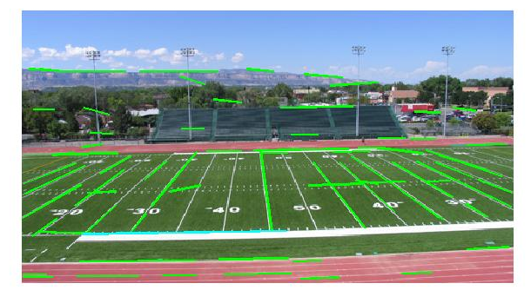
Showing longest segments found
Kristen Grauman

Slide 43
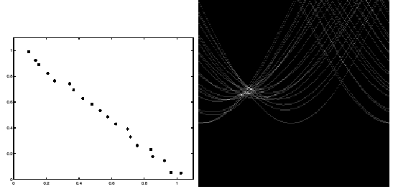
Impact of noise on Hough
y
d
x
θ
Image space
edge coordinates
Votes
What difficulty does this present for an implementation?
Slide credit: Kristen Grauman

Slide 44
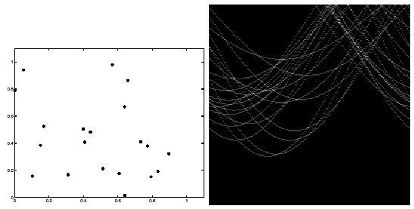
Impact of noise on Hough
Image space
edge coordinates
Votes
Here, everything appears to be “noise”, or random edge points, but we still see peaks in the vote space.
Slide credit: Kristen Grauman

Slide 45

Hough transform for circles
Circle: center (a,b) and radius r
Equation of circle?
For a fixed radius r
Equation of set of circles that all pass through a point?
Image space
Hough space
Adapted by Devi Parikh from: Kristen Grauman

Slide 46
Hough transform for circles
Circle: center (a,b) and radius r
For a fixed radius r
Intersection: most votes for center occur here.
Image space
Hough space
Kristen Grauman

Slide 47
Hough transform for circles
Circle: center (a,b) and radius r
For an unknown radius r
r
?
b
a
Image space
Hough space
Kristen Grauman

Slide 48

Hough transform for circles
Circle: center (a,b) and radius r
For an unknown radius r
r
b
a
Image space
Hough space
Kristen Grauman

Slide 49

Hough transform for circles
Circle: center (a,b) and radius r
For an unknown radius r, known gradient direction
x
θ
Image space
Hough space
Kristen Grauman

Slide 50
Hough transform for circles
For every edge pixel (x,y) :
For each possible radius value r:
For each possible gradient direction θ:
// or use estimated gradient at (x,y)
a = x – r cos(θ) // column
b = y + r sin(θ) // row
H[a,b,r] += 1
end
end
Kristen Grauman

Slide 51


Example: detecting circles with Hough
Original
Edges
Votes: Penny
Note: a different Hough transform (with separate accumulators) was used for each circle radius (quarters vs. penny).
Slide credit: Kristen Grauman

Slide 52
Example: detecting circles with Hough
Combined detections
Edges
Votes: Quarter
Slide credit: Kristen Grauman
Coin finding sample images from: Vivek Kwatra

Slide 53




Example: iris detection
Gradient+threshold
Hough space (fixed radius)
Max detections
Hemerson Pistori and Eduardo Rocha Costa http://rsbweb.nih.gov/ij/plugins/hough-circles.html
Kristen Grauman

Slide 54


Example: iris detection
An Iris Detection Method Using the Hough Transform and Its Evaluation for Facial and Eye Movement, by Hideki Kashima, Hitoshi Hongo, Kunihito Kato, Kazuhiko Yamamoto, ACCV 2002.
Kristen Grauman

Slide 55

Hough Voting for Object recognition

Slide 56

Hough Voting for Object recognition

Slide 57

Hough Voting for Object recognition

Slide 58
Hough transform: pros and cons
Pros
All points are processed independently, so can cope with occlusion, gaps
Some robustness to noise: noise points unlikely to contribute consistently to any single bin
Can detect multiple instances of a model in a single pass
Cons
Complexity of search time increases exponentially with the number of model parameters
Non-target shapes can produce spurious peaks in parameter space
Quantization: can be tricky to pick a good grid size
Kristen Grauman

Slide 59


ICCV 2019
Or Litany

Slide 60

Or Litany

